Slide 1
Eress Across Europe - Expanding Collaboration
Dyre Martin Gulbrandsen
Director Eress
Eress Forum 2026
Notes:
Dear Railway and Energy Colleagues!
First of all, I would like to thank DB Energie for the effort you have put into organizing this year's Eress Forum together with us in Eress.
I also hope that all of you will take full advantage of this Forum — not only to share and gain knowledge, but also to exchange experiences and strengthen our professional network in a good astrosphere.
And what better place to do that than here in the vibrant city of Frankfurt, which offers the perfect setting for both productive discussions and enjoyable moments together.
Since 2013, Eress, our partner countries, and DB Energie have maintained an exchange of energy metering data, enabling accurate settlement and cross-border interoperability between Germany and the Eress countries. This cooperation is built on transparency and a standardised way of working, ensuring that data flows consistently and securely across national borders. It also ensures that railway undertakings are invoiced for traction energy based on actual measured consumption, rather than unreliable estimates.

Slide 2
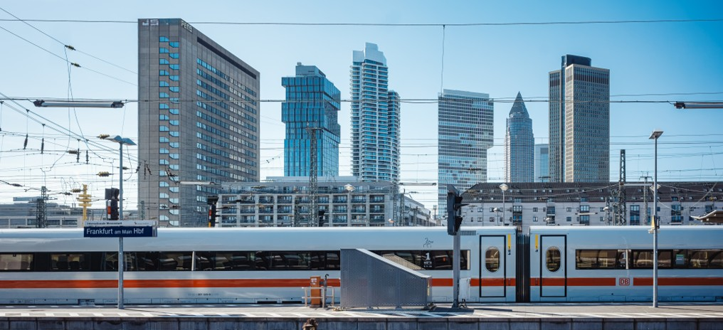
The Eress Way
Notes:
With 10 partner countries, Eress has strengthened its position as a leading European partnership for railway energy, ensuring efficiency, transparency, and sustainability.
Through a collaborative and standardised approach, we enable seamless cross-border energy management—reducing complexity, improving data quality, and ensuring fair and consistent invoicing.
This model, combined with lower costs for each partner, is what sets Eress apart.
Looking ahead, we will continue to strengthen collaboration, expand our partnerships, and develop user-friendly solutions—while simplifying cross-border acceptance of energy metering systems.

Slide 3

Study on the implementation of on-ground energy data collecting systems in the EU railway system
Notes:
Earlier this year, the European Commission published the report from Additional Study 03, carried out by the European Union Agency for Railways, ERA.
The report provides a comprehensive overview of the current status of traction energy measurement, data collection, settlement, and billing.
It also highlights key challenges and differences in implementation across Europe.
I’m really looking forward to the session in today's programme that will explore this topic in more detail.
Eress is ready to contribute its expertise.
We will support both the sector and the European Commission as the follow-up to the ERA study moves into concrete actions.
We believe this will lead to greater transparency, more efficient processes, and stronger collaboration across Europe.

Slide 4
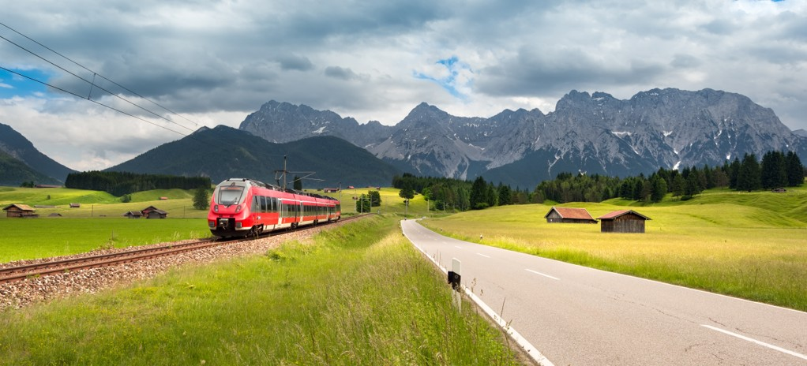
Master Data
Notes:
This project establishes a trusted and unified master data source for energy meters and electric traction units across our parterns.
It builds on the common rules established through the IRS 90930 work.
The project brings together data from multiple stakeholders into one consistent, high-quality dataset.
This reduces duplication, improves cross-border consistency, and ensures reliable, up-to-date information.
Our ambition is to make this Master Data solution the most trusted and up-to-date source for infrastructure managers, railway undertakings, and vehicle keepers.
The project will strengthen data quality, integrity, and availability.
At the same time, it enables more efficient collaboration and lowers overall costs through one consistent, shared solution

Slide 5

Smart Use of Data
Notes:
Building on the Erex foundation, this project enables the development of advanced statistics, analytics, and performance indicators.
It unlocks new opportunities, including predictive analytics, the use of artificial intelligence, and improved energy efficiency strategies.
Ultimately, it will help Eress partners fully unlock the value of their data.

Slide 6

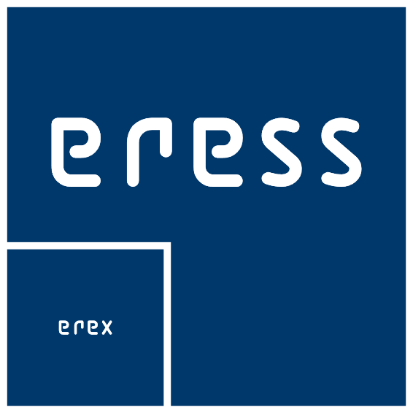
Eress Test Partner
Notes:
Many European countries still have some way to go before fully complying with current energy metering and settlement legislation. This is confirmed in the ERA Study.
Eress offers a proven solution: low initial investment, comprehensive training, and a modern, stable technical platform. That’s why our partners see Eress as a win-win — both individually and collectively.
Our approach is simple and effective: interested parties can begin as Eress Test Partners. This allows them to explore and evaluate a complete energy metering and settlement solution — at low cost and without the need to commit as a full partner from the start.
After the test period, the organization can decide whether to join the Eress partnership.
In recent years, several new partners have joined Eress through this model. While settlement solutions are inherently complex, we’ve developed a fast and standardized onboarding process. A key element is the onboarding week, where experts from both the test partner and Eress work side by side.
This week is intensive, collaborative, and highly effective. Challenges are addressed together, knowledge is transferred quickly, and by the end of the week, a working settlement solution is in place. And yes — it’s also social and fun!
With the onboarding of Portugal, we’ve further streamlined this process — making it even more efficient for future partners.

Slide 7
Notes:
Thank you for your attention. I now give the floor back to our moderator Dag Storhaug.

