Slide 1
Kjetil Mikelborg
Chairman Steering Group
Eress User Forum 2026
Frankfurt

Slide 2

Eress in Croatia

Slide 3


Slide 4
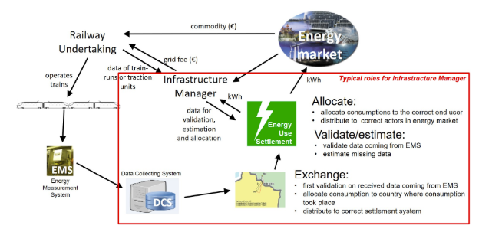

Slide 5
