Slide 1
Eress Exchange
Overview

Slide 2
Eress has established Standardized Exchange of Energy Metering Data with other countries, according to the data exchange framework developed by the IRS 90930 working group.
Promoting standardised solutions
In addition to fully working together, Eress 10 current partners do collaborate with other countries in Europe, exchanging Energy Metering Data.

Slide 3
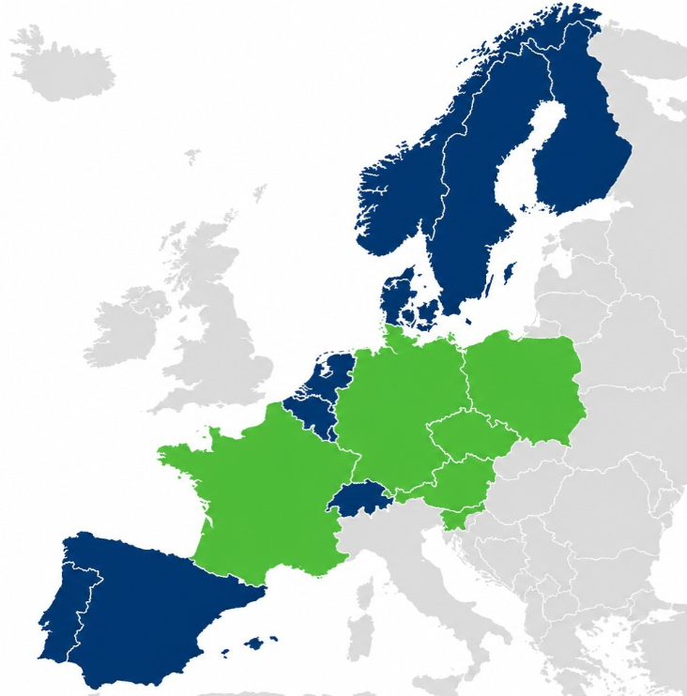
Exchanging data with…
Per today, Eress current 10 partner countries do actively exchange energy metering data with the following countries:
France: SNCF (since 2011), RTE (xml since 2023)
Germany: DB Energie (since 2013, XML since 2023)
Austria: ÖBB (since 2013, XML since 2024)
Slovenia: SŽ – Infrastruktura (since 2026)
Czech Republic: Správa železnic (since 2026)
Poland: PGE Energetyka Kolejowa Operator (since 2026)

Slide 4
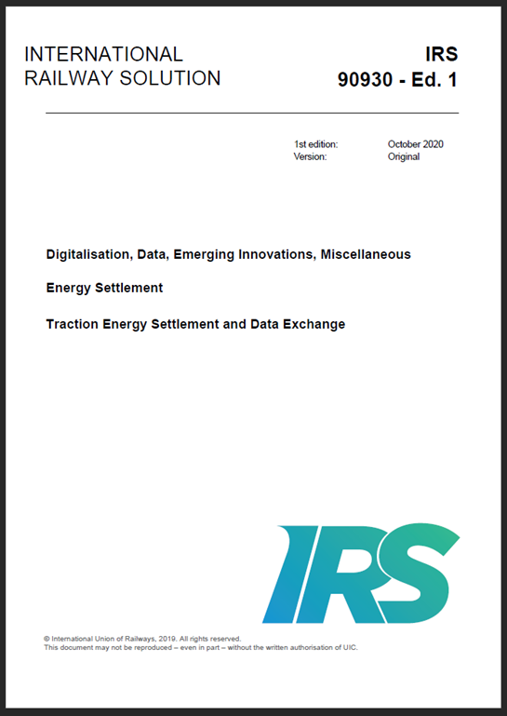
Cooperation across boarders IRS 90930
A joint European commitment, anchored in the Sector Declaration on Traction Energy Metering and Settlement.
Facilitates the transition to accurate measurement and settlement based on verified energy data.
Originally published in 2020; a revision of the framework is currently in progress, with publication anticipated in 2027.
Possible to opt in for new project-work starting from 2027
IRS 90930 is available free of charge via the UIC online shop: https://shop.uic.org

Slide 5
Some work ongoing IRS90930
Adaptation to new regulations
Adjust the IRS to changes in the TSIs and EN 50463, including hybrid trains, a clearer distinction between the Consumption Point and the Energy Measurement System (EMS), and the requirement to use only secure protocols (HTTPS).
Development of the data and role model
Further develop message exchange (XSDs), including improved integration with EN 50463. Assess potential extensions to the role model (e.g., ECM) as well as simplification of message flows.
Support for hybrid trains and new use cases
New requirements and use cases for hybrid and plug‑in hybrid trains. Clarification of train‑operation data, operating modes, and the handling of charging/discharging.
Clearer framework for energy settlement
The IRS currently contains few requirements for the settlement process itself — assess minimum requirements for Energy Use Settlement, drawing on work carried out by ERA.
Structure and simplification
Consider relocating annexes and process descriptions to external appendices to create a more streamlined core IRS.

Slide 6
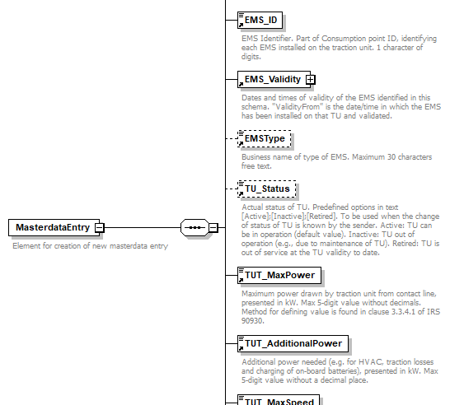
Masterdata exchange
Ongoing development and testing for the Exchange of Masterdata by XML as well
Hear more from Dag Storhaug later today

Slide 7
Eress simplifies the complexity of cross‑border rail operations, boosting efficiency, strengthening transparency, and helping operators work seamlessly across national borders.
We all are on the same Railway path

Slide 8

If you are an Infrastructure Manager…
and are interested in establishing an Exchange Connection with Eress countries, please contact us

Slide 9
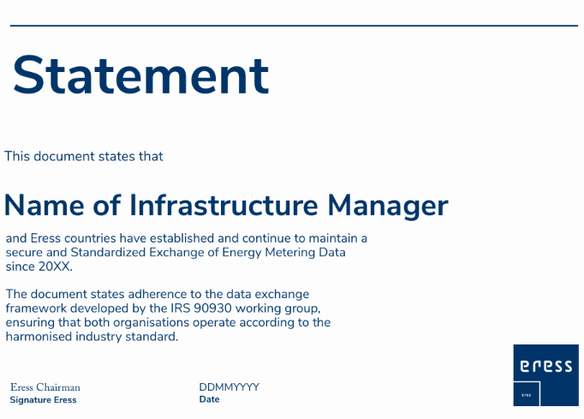
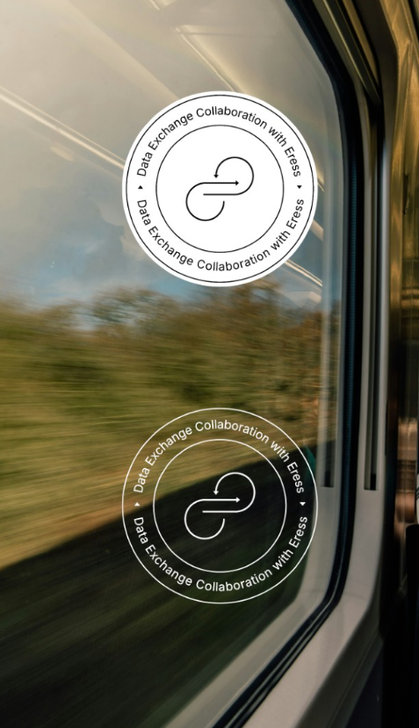
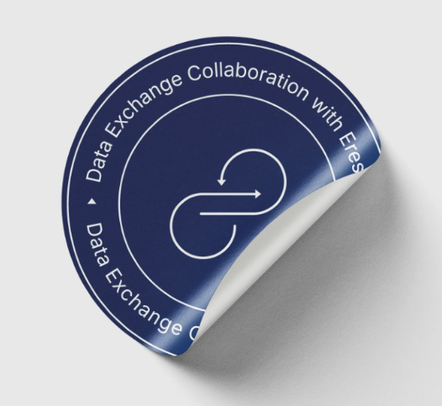
If you are an Infrastructure Manager…
and would like us to issue a statement or a stamp to publish online confirming that we are working on the same harmonised standard, please contact us

Slide 10
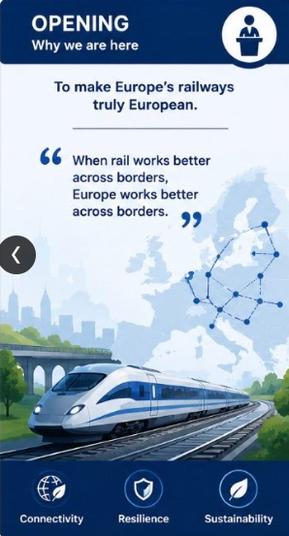
Today
“The expertise exists.
The technology exists.
The commitment exists.
It requires trust.
Shared standards.
Shared objectives.
And shared innovation.”
Linda Thulin, Trafikverket, Vice-president RNE,
leaded ScanMed Corridor
Europe Rail Event:
Cross Border Operations, May 2026

