Slide 1
Status EN 50463
Bart Van der Spiegel, Infrabel

Slide 2






EN 50463: history
Started on request of European Commission and ERA in 2007.
First edition of EN 50463 series published in 2012.
TSI LOC&PAS and TSI ENE of 2014 referred to EN 50463:2012. EMS became mandatory on all new, renewed and upgraded trains.
An interface between two TSIs shall be uniquely defined.
A second edition of EN 50463 series was published in 2017. This version included a first protocol for the communication between the Energy Measurement System (EMS) on-board and a Data Collecting System (DCS) on ground.

Slide 3

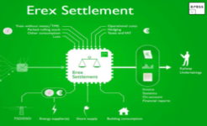

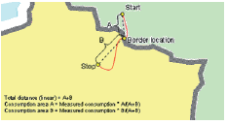

Railway Undertaking
commodity (€)
Energy market
requests train-runs
grid fee (€)
operates trains
TEL TSI:2026 makes
Train Composition Message
mandatory
Infrastructure Manager
kWh
Settlement
Allocate:
allocate consumptions to the correct end user
distribute to correct actors in energy market
kWh
data for validation, estimation and allocation
LOC&PAS TSI:2018
Support retrofit in 2023
Update expected in 2027
EN 50463:2017
New version end 2026
TEL TSI:2026 makes
Train Composition Message
mandatory
Validate/estimate:
validate data coming from EMS
estimate missing data
EMS
ENE TSI:2018
Update expected in 2027
EN 50463:2017
IRS 90930:2020
CIR EU/2018/868
IRS 90930:2020
On-board Energy Measurement System
Exchange:
allocate consumption to country where consumption took place
distribute to correct settlement system
DCS
CIR EU/2018/868
IRS 90930:2020
Update expected in 2027
Data Collecting System on ground

Slide 4
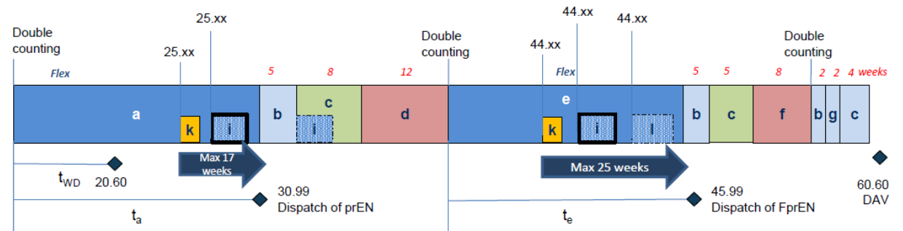
EN 50463: start of new Working Group 37
EN 50463
31/10/2025
Dec 2026
4/9/2025
23/1/2026
27/4/2026
18/7/2025
21 meetings
Secretariat
enquiry
Translation
prEN 50463
FprEN 50463
QC
QC
HAS
CCMC
HAS
Enquiry
HAS
HAS
Translation
Enquiry
Translation
Jul 2026
Apr 2025
Apr 2026
Nov 2023
& Jan 2025
FprEN 50463
Correct referencing possible
Input on how EN should be adjusted to fit new clauses of TSI
22/9/2025 > …
TSI LOC&PAS
TSI ENE
Ad-hoc group revision EMS clauses in TSI
Draft for
prEN 50463
Revision TSIs
Dec 2026
16/9/2025 > …
Cybersecurity
With experts of EN 50463, ERA and ERJU
4

Slide 5
Main changes to EN 50463
Distinction between energy measurement system (EMS) and consumption point (created during the installation of an EMS on board)
Introducing general clause and an informative annex on Cybersecurity
Introducing multiple changes for hybrid trains
Clarifying process of commissioning and maintenance
Introducing possibility to have integrated energy measurement function combining current measurement, voltage measurement and energy calculation
Enabling other sources for location data next to data coming form satellites
Introduce secure protocols (HTPPS)
Add possibility of a direct connection on-board
Add standardised digital signature, uncompressed payloads and mechanism for a batch of samplings at a higher frequence (e.g. every second)
The same protocol will be used in EN 50463 and IEC 62888
Ensuring NoBo verifies reverification procedure and design review of integration and installation
Adding possibility to use mobile testing equipment to verify accuracy without dismounting
5

Slide 6

Timeline
September-October: possibility to vote and to introduce editorial comments to EN 50463 (CENELEC)
December 2026: approval of EN 50463 (CENELEC)
December 2026: report with proposal of changes to TSI (ERA)
February or June 2027: approval by RISC of Commission Implementing Regulation (EC) adopting the changes to TSI
May or September 2027: possibility to vote on Amendments on EN 50463 (adjusting Annex ZZs to new LOC&PAS TSI)
December 2027: Edition 2 on IRS 90930 (UIC)
6

