Slide 1

ERESS Forum 2026 (Frankfurt)
03/06/2026
ERA AS-03 Report on Rail Energy Metering: AERRL Perspectives and Next Steps, Sebastian Rodriguez, Member of AERRL Subgroup Energy Settlement

Slide 2
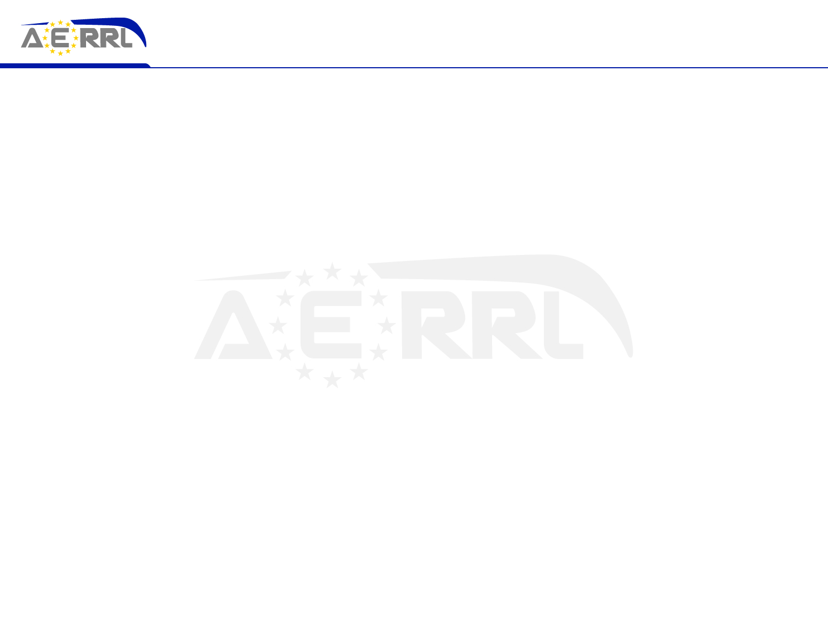
AERRL's Prior Analysis: Confirmed by the ERA Study
AERRL raised the key issues before AS-03 was commissioned
What AERRL had already identified
What AS-03 confirms
Fragmentation of national approaches to energy settlement
Limited interoperability of Energy Measurement Systems (EMS)
Absence of a fully harmonised EU framework for energy data
Barriers to effective cross-border rolling stock operations
The same structural deficiencies exist across Member States
Significant implementation gaps persist in the current framework
Main challenges lie in incomplete & inconsistent implementation not in the absence of legislation
AERRL's input has contributed to shaping the regulatory discussion
AERRL's analysis has been recognised and has contributed to shaping the current regulatory discussion
2

Slide 3
ERA AS-03: A Fragmented and Incomplete System
Key findings from the study
13
7
2+
Member States non-compliant
with TSI ENE requirements
Member States allow genuine
energy supplier choice
EMS systems often deployed
on a single cross-border loco
Fragmented data & standards
Consequences for rolling stock lessors
National EMS requirements and infrastructure-specific constraints continue to apply
Data exchange models vary widely -> no consistent cross-border standard
Interface between railway and energy legislation remains undefined at EU level
Increased costs and technical complexity in cross-border operations
Limited interoperability of assets across national networks
Reduced investment predictability -> the system does not function as a true European market
3

Slide 4
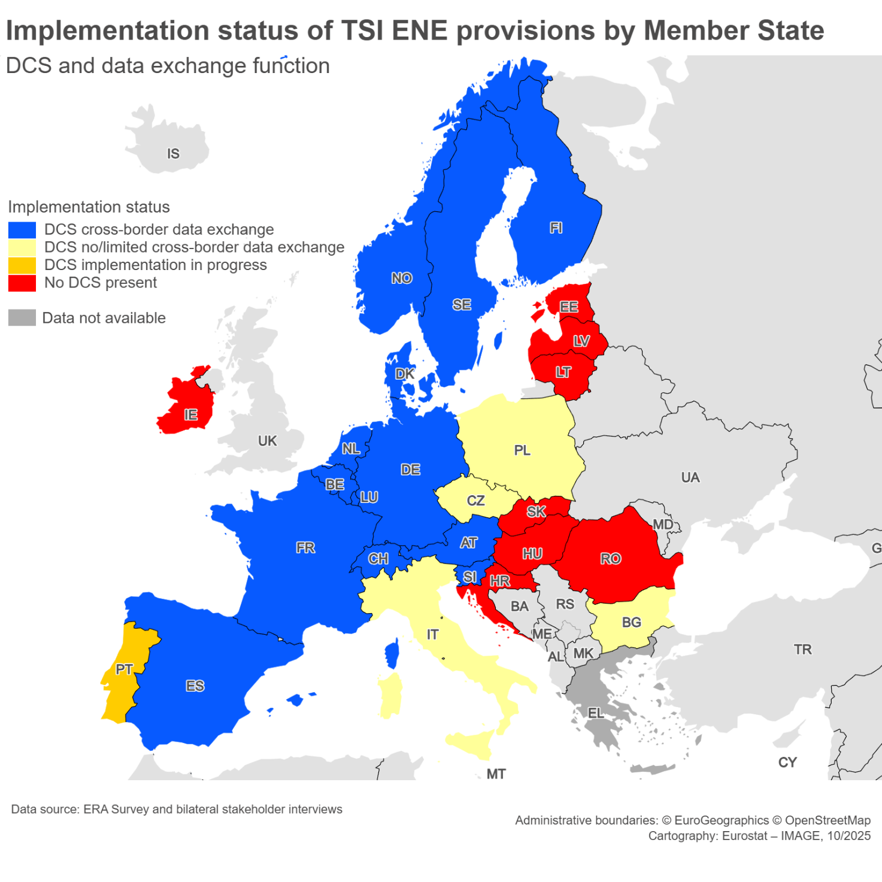
ERA AS-03: A Fragmented and Incomplete System
Key findings from the study
13
Member States non-compliant with TSI ENE requirements
Bulgaria → DCS exists but no cross‑border data exchange (except a specific case with Austria)
Croatia → No DCS in place. Expected DCS by 2027.
Estonia → No DCS, billing based on substations.
Greece → No information available, indicating lack of compliance.
Hungary → No DCS, no data exchange.
Ireland → No DCS, network partially outside the TSI scope.
Italy → DCS exists but no cross‑border data exchange.
Latvia → No DCS, billing via substations.
Lithuania → No DCS, billing via substations.
Poland → Obsolete DCS, no international data exchange. New DCS under implementation and testing.
Portugal → DCS under development (Eress DCS), fleet poorly equipped.
Romania → No DCS, billing based on estimates.
Slovakia → No DCS, billing only based on estimates.
3

Slide 5
ERA's Recommendations: AERRL's Assessment at a Glance
Strong support
Partial Support
Requires Review
Rec.
ERA Recommendation
AERRL Position
Rec. 1
Enforce existing TSI ENE requirements / full DCS deployment
Strong support
Rec. 2
Mandatory train composition messages & standardised data exchange
Strong support
Rec. 3
Improve dissemination, knowledge sharing & capacity building
Strong support
Rec. 5
Extend ENE TSI to Regulate Data Exchange and Energy Settlement Processes
Strong support
Rec. 7
Strengthen regulatory status / harmonise EMS (interoperability constituents)
Strong support
Rec. 6
Explore costs & benefits of a more integrated European DCS approach
Partial Support
Rec. 8
Clarify applicability of the Measurement Instruments Directive (MID)
Partial Support
Rec. 9
Clarify interface between railway and energy market legislation
Partial Support
Rec. 4
Mandatory assessment of DCS as a condition for infrastructure authorisation
Requires Review
4

Slide 6
Priority Recommendations: AERRL Strongly Supports
Where ERA's direction aligns fully with AERRL's longstanding positions
AERRL Supports
5
Rec. 1
Rec. 5
Full deployment & enforcement of compliant DCS
Extend ENE TSI to Regulate Data Exchange and Energy Settlement Processes
The core issue is not missing rules but incomplete implementation. All Member States must deploy DCS capable of exchanging billing data. This is a prerequisite for a structured European energy settlement system and for third-party access to energy supply.
Harmonising data exchange and settlement under the ENE TSI would eliminate today’s fragmented national practices, ensuring consistent cross‑border billing and smoother interoperability for all railway actors.
Rec. 2
Rec. 7
Mandatory train composition messages & automated data flows
EMS as interoperability constituents / harmonisation & cross-acceptance
The absence of systematic data sharing leads to manual processes and reporting burdens. Standardised and automated exchange between railway undertakings, IMs and DCS would reduce administrative burden and improve settlement accuracy.
Classifying EMS as interoperability constituents is key to reducing fragmentation, eliminating duplicative certification and enabling cross-acceptance across national networks. For lessors, this directly improves asset interoperability and investment predictability.

Slide 7
Rec.4: DCS as a Condition for Infrastructure Authorisation
AERRL agrees in principle -> but a key concern must be addressed
ERA Proposal: The presence of a compliant DCS should be made a condition for the authorisation of infrastructure placed in service. This is intended to accelerate the deployment of DCS across the European network.
AERRL Position: Support, in principle, for strengthening DCS deployment but there is a key concern.
Would equivalent requirements apply to rolling stock owners?
Rolling stock not equipped with compliant EMS would face similar constraints.
Rec. 4 -> significant compliance obligation on Infrastructure Managers (IMs)
Key Concern: Risk of Regulatory Asymmetry
AERRL calls for a consistent and proportionate approach: if DCS compliance is to become a condition for infrastructure authorisation, it is essential to assess whether a symmetric obligation should apply to rolling stock — to ensure a level playing field across all actors in the system.
6
Notes:
Amendment of Table B.1 of TSI ENE (mandatory DCS assessment)
Without a mandatory assessment requirement in the regulatory framework, DCS compliance cannot be effectively verified and implementation risks remaining partial and inconsistent across Member States.

Slide 8
Recommendations Requiring Careful Implementation
AERRL supports the direction but implementation details matter
Partial Support
Rec. 6 - Towards a More Integrated / Joint European DCS
AERRL supports exploring the costs and benefits of a more integrated European DCS approach, which could deliver efficiency gains and reduce duplication. However, full centralisation raises concerns: single point of failure, cybersecurity risks, and reduced flexibility. AERRL's priority is interoperability and effective implementation not over-complex structural change.
Rec. 8 - Clarifying MID Applicability
Legal clarity on the Measurement Instruments Directive (MID) is necessary and AERRL supports this. However, EMS and MID instruments follow different technical and operational logics. Any alignment must avoid creating additional complexity or duplicating certification requirements. The goal is clarity, not additional burden.
Rec. 9 - Interaction Between Railway and Energy Legislation
Clarifying the boundary between railway and energy market legislation is essential. Current ambiguity creates uncertainty over responsibilities, infrastructure ownership and cost allocation especially where energy supply and railway infrastructure are managed by separate entities.
Priority should be given to interoperability and effective implementation over potentially over-complex structural changes
7

Slide 9
From Rules to Reality - Closing the Implementation Gap
The core issue
AERRL's priorities
AERRL's commitment
AERRL remains committed to supporting pragmatic and workable solutions, promoting interoperability across borders, and ensuring a market-oriented, proportionate European framework for rail energy settlement.
The fundamental problem is not the absence of regulation. It is the lack of consistent implementation and harmonisation across Member States.
Enforcement of existing requirements
Automated and standardised data flows
Full harmonisation and cross-acceptance of EMS
Legal clarity at EU level
Without decisive action, interoperability will remain limited and the ambition of a Single European Railway Area will continue to be constrained.
8

Slide 10
Q&A
Questions & Discussion
Sebastián Rodriguez | AERRL | ERESS Forum 2026

