Slide 1
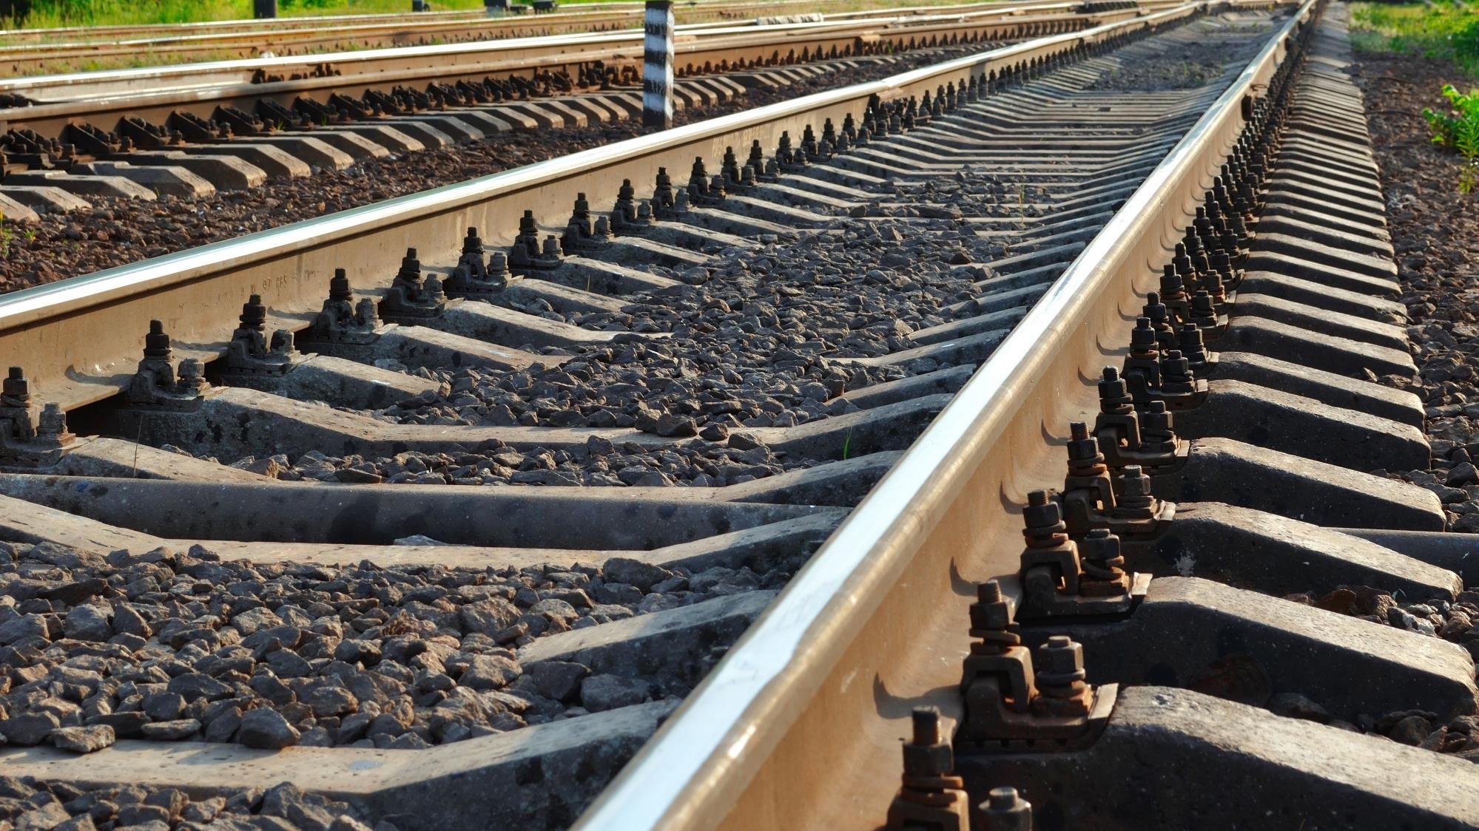


ERA study on rail traction energy measurement and consumption data exchange
Eress Forum, 3 June 2026, Frankfurt
Giacomo Potenza, Veronika Nöllke Sárik
Photo: Adobe Srock / by Tarasylo

Slide 2
Study objective
The European Commission request:
Evaluate the state-of-play of on-ground Data Collecting Systems (DCS), as defined in TSI ENE Article 9, point 4 of Commission Implementing Regulation (EU) 2018/868
Assess issues affecting energy metering in railways:
  Problems for implementers of DCS on-ground, Energy Metering System (EMS) on-board
  National rules or IM requirements impacting interoperability and free choice of energy supplier
  Problems for metering data exchange and settlement
  Technical and authorisations hurdles
Provide a list of recommendations on identified challenges

Slide 3
Study AS-03 methodology
The project ran from January to December 2025 :
Desk research
A large web survey of RUs, IMs, NSAs, MS, train manufacturers, EMS/DCS suppliers, vehicle lessors, NoBo, DeBo. >80 detailed replies, summary of results at the Eress Forum
38 bilateral interviews with excellent EU covergae, attendance to UIC and ERJU System Pillar Task 1 workshops
Collaboration as advisor with Eress, UIC, SP Task 1 and CEN/Cenelec given parallel workstreams
Assessment of 180+ comments to the draft final report
Workshop on the draft final report on 10 December 2025
ERA independent analysis and drafting of recommendations
Final report published in March 2026

Slide 4
Study findings, situation till December 2025
Open discussion
Photo: Adobe Srock / by Tarasylo

Slide 5
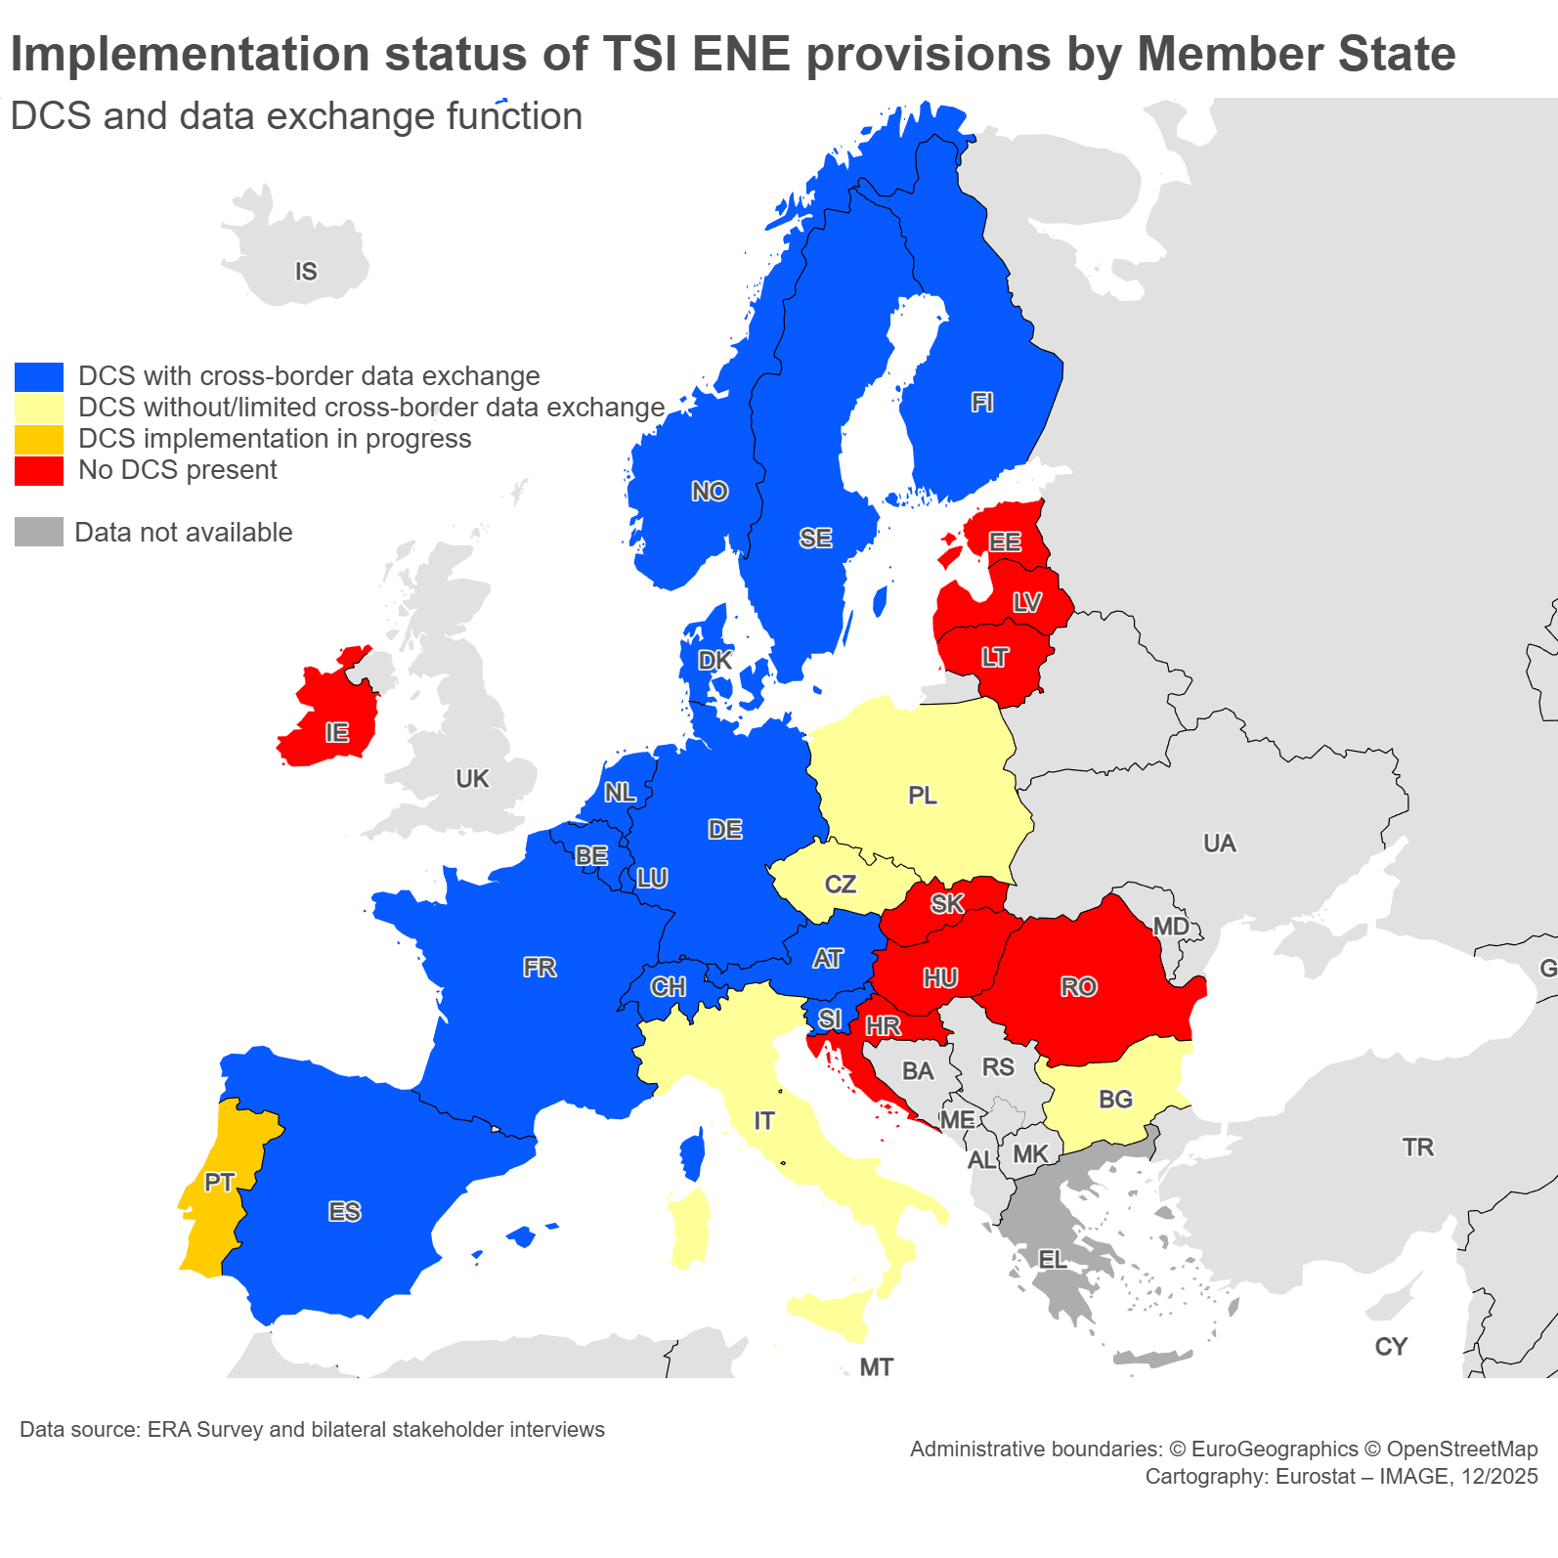
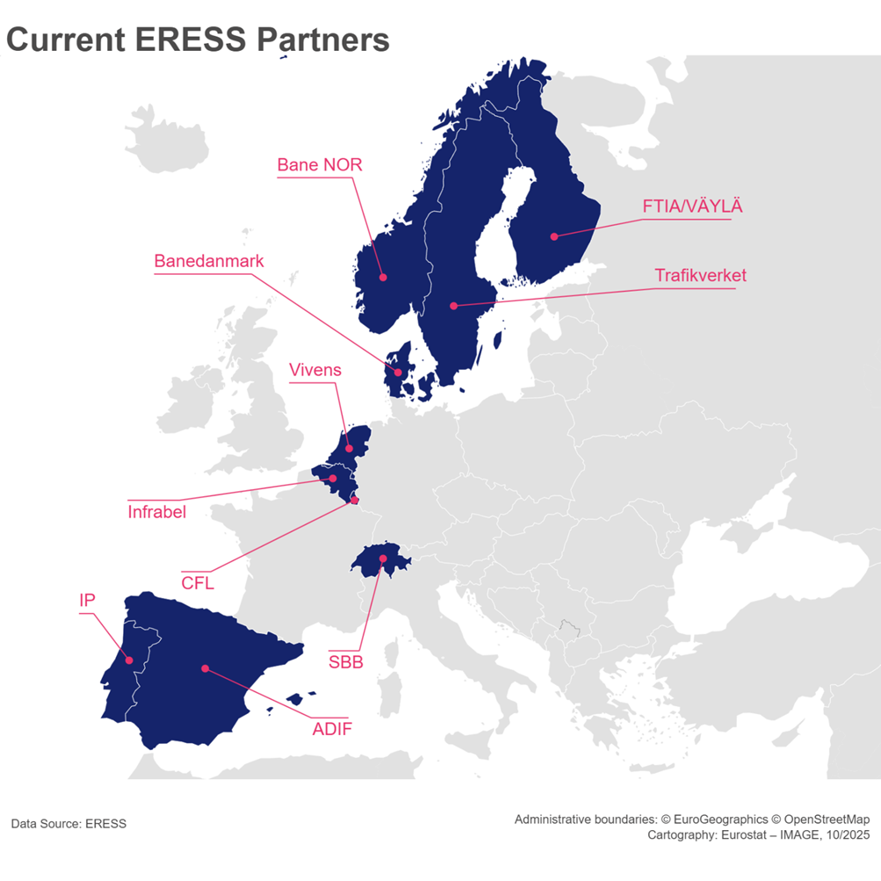
Study key findings: state-of-play of on-ground DCS, as defined in TSI ENE
DCS are implemented by IMs except in FR, DE, PL
Some IMs share DCS or exchange function through Eress

Slide 6
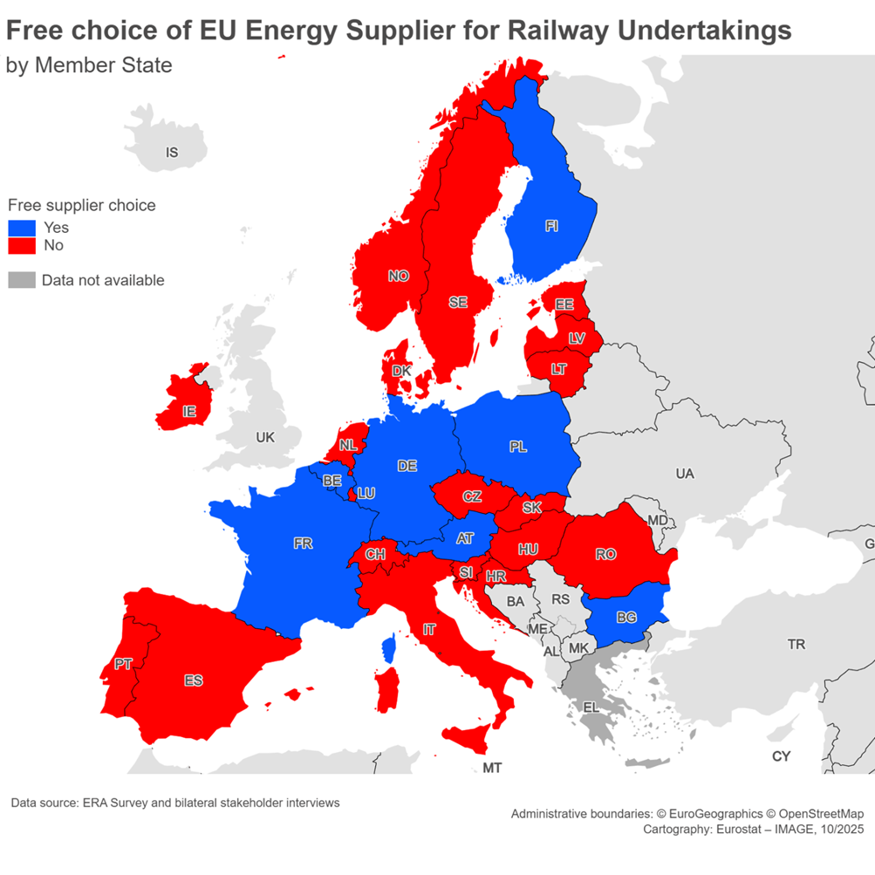
Study key findings: third party access for RUs in the energy supply market
In some MS national law mandates the IM being the sole energy provider for RUs
In some MS, RUs can choose their energy supplier only for domestic trains
In NL since 2008 the purchasing group Vivens by Prorail and all RUs is in use. Free choice of supplier as of 2028
In BE no RU opted for an alternative to Infrabel’s supply
In IT traction energy is considered cheap for the DC network as it is subsidised by government for historical reasons

Slide 7
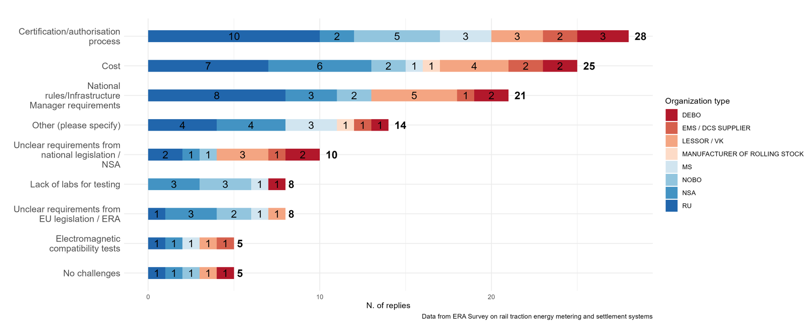
Study key findings: different issues affecting energy metering
Data quality and data sharing corporate policies affecting the ability of exchange function to match consumption with actual tractive vehicle operators
Difficult EMS certification/authorisation, different IMs/DCS requiring own calibration, certifications, seals, installation, cybersecurity requirements etc to accept data from whatever compliant EMS
What are the key challenges to install/retrofit EMS on-board to comply with latest LOC&PAS TSI?

Slide 8
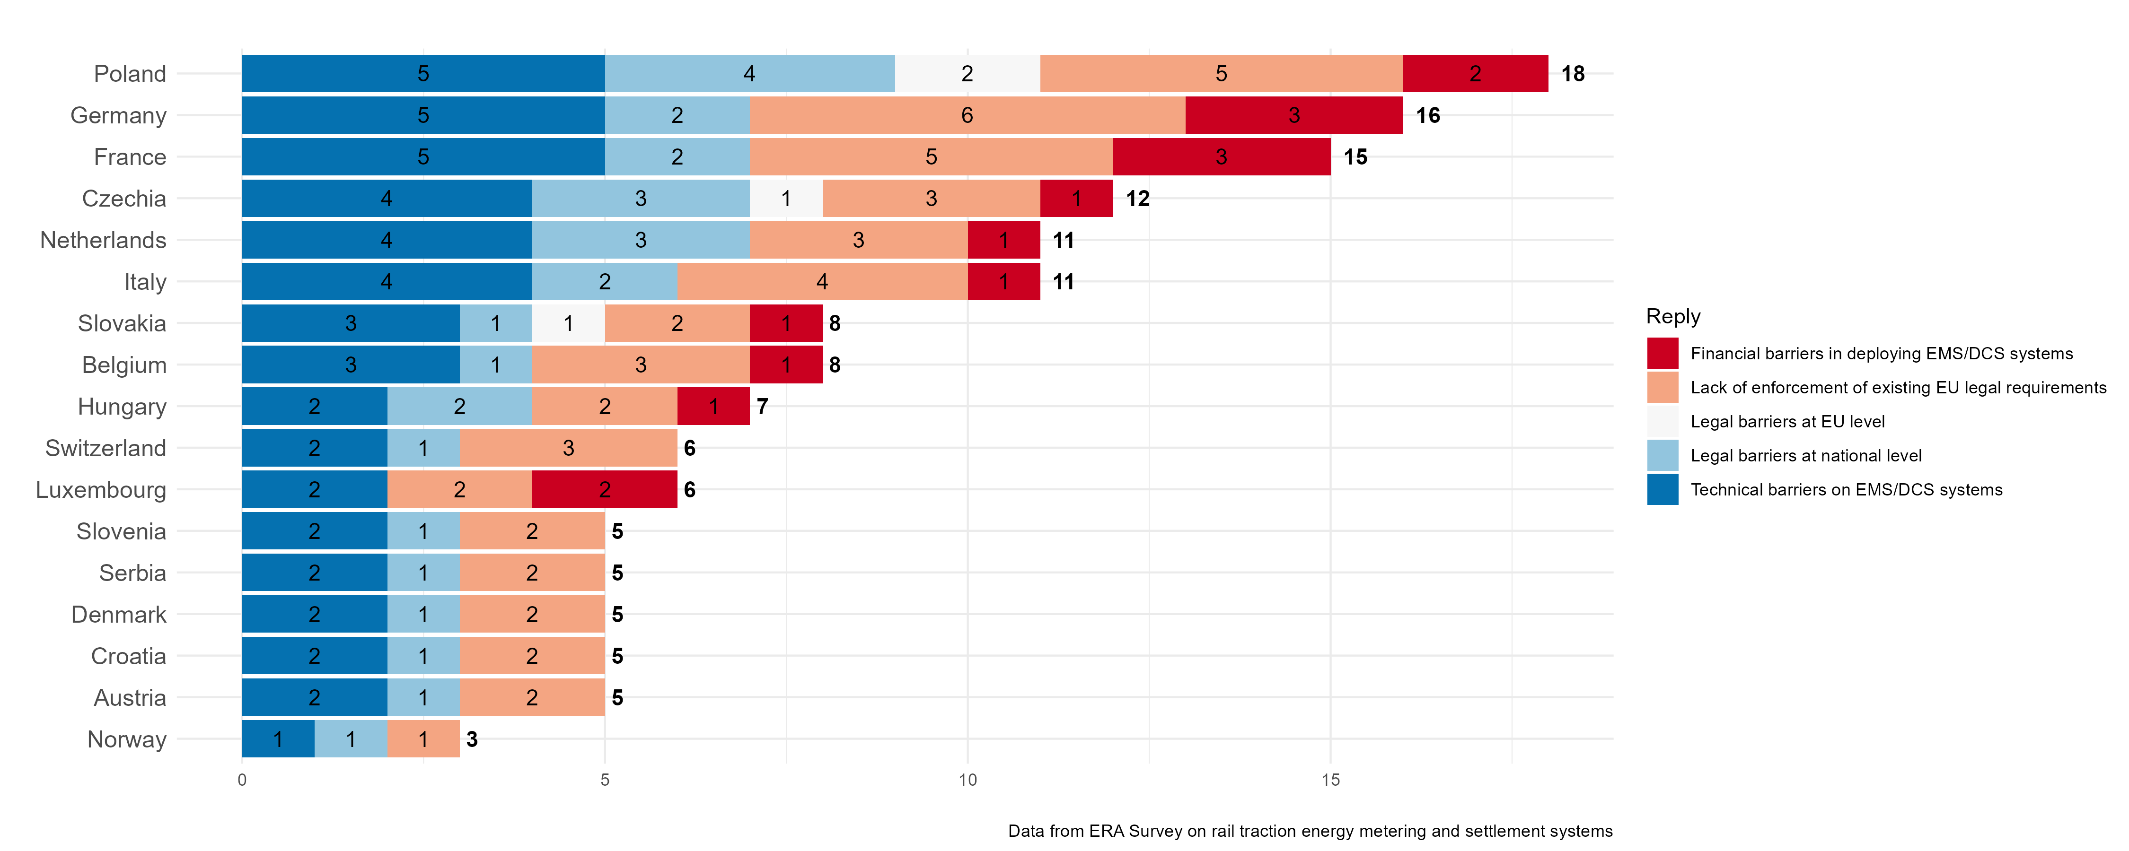
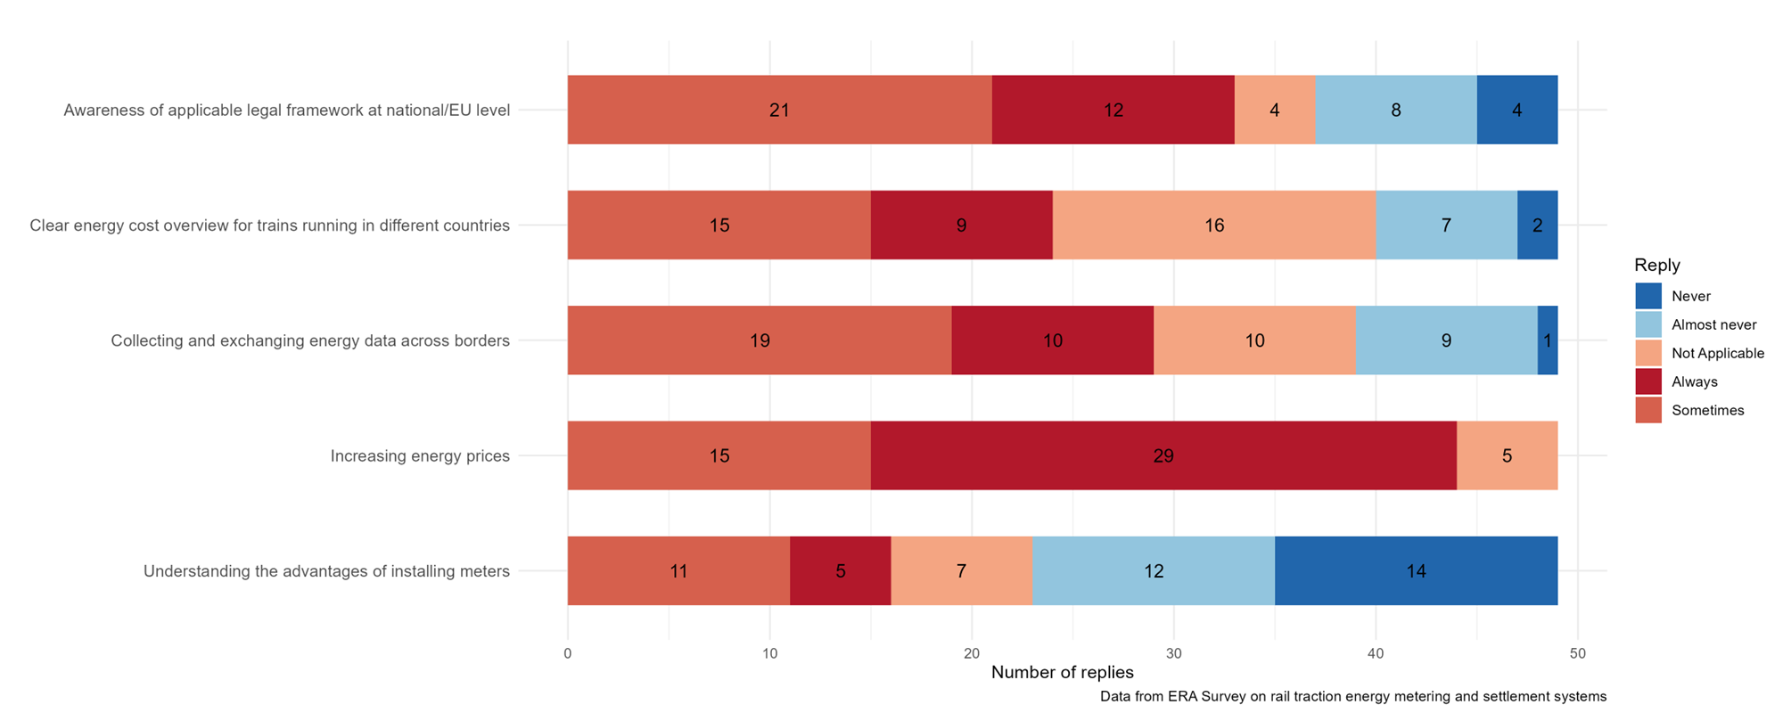
Study key findings: different local issues affecting energy metering
TSI ENE not applied everywhere, DCS still not present in some MS
Different barriers, low knowledge of legal requirements and data frameworks for energy metering
Uncertainty regarding the applicability of other EU legislation affecting potentially EMS and billing of grid fees

Slide 9
Study key findings: focus on Germany
Long tradition of rail traction energy metering and peculiar corporate structure of DB Energie being an energy generator, supplier, DSO, DCS part of DB Group;
DB Energie subject to regulatory oversight by the energy chamber of the Bundesnetzagentur (BNA) and EU energy sector legislation
Several rulings by the Federal Court of Justice about grid fees approvals and market and regulatory position of DB Energie as DSO vs DB InfraGo as rail IM and overhead catenary provider
BNA decision in 2022 to implement from July 2026 a new reporting scheme for rail vehicle owners/keepers. Purposes:
  Shifting of matching duty of EMS data from DB Energie to vehicle owners/keepers to ensure billing to the actual RU operating a vehicle
  Reduced mistakes and liability from incorrect billing based on current more manual data submissions and data matching
  More responsibility of lessors or keepers in case of missing data for correct billing
New scheme perceived as heavy by lessors/keepers

Slide 10
Study Recommendations
Recommendations | Perceived position of rail sector stakeholders | Follow-up actions
1. Consider enforcing ENE TSI’s existing requirements | Full Support | On-going enforcement follow-up following EC procedures
2. Make use of mandatory train composition messages data flow from RUs to IMs applicable in rail telematics | Full support | Commission Regulation (EU) No 2026/253 (Telematics TSI) adopted February 2026 Rail sector to implement Regulatory bodies to oversee
3. Improve dissemination and knowledge sharing on traction energy metering | Full support | Eress Forum ERA study workshop and communication Availability for other dissemination
4. Analyse the opportunity to amend Table B.1 in Appendix B to ENE TSI | Mixed views on NoBo’s involvement | Change request for processing amendments of ENE TSI in ERA processes

Slide 11
Study Recommendations
Recommendations | Perceived position of rail sector stakeholders | Follow-up actions
5. Analyse the opportunity to extend the scope of application of ENE TSI into the data exchange function and settlement processes | Full Support | Change request for processing amendments of ENE TSI in ERA processes
6. Explore the costs and benefits of one DCS and settlement system at the EU level. | Mixed views | Analysis of options for ENE TSI revision following ERA processes Consideration of R&D need for a reference DCS for testing purposes
7. Analyse the opportunity to amend TSI LOC & PAS by making EMS an interoperability constituent. | Mixed views | Analysis of options within TSI revision following ERA processes
8. Analyse and potentially clarify the applicability of Directive (EU) 2014/32/EU on measurement instruments (MID) to EMS. | Full Support | Internal analysis following EC procedures

Slide 12
Study Recommendations
Recommendations | Perceived position of rail sector stakeholders | Follow-up actions
9. Consider the potential need to analyse the legal status of IMs and energy supply with regard to traction current infrastructure and services in Member States | Full Support | Internal analysis following EC procedures
10. Analyse the status of EMS and DCS in respect of EU cybersecurity legislation. | Full Support | On-going analysis within TSI revision following ERA processes
11. Consider R&D on EMS telecommunications | Mixed views | Dedicated provisions considered within FRMCS specifications

Slide 13
Closing remarks
Veronika Nöllke Sárik | Policy Officer, European Commission (DG MOVE Unit C4)
Photo: Adobe Srock / by Tarasylo

Slide 14
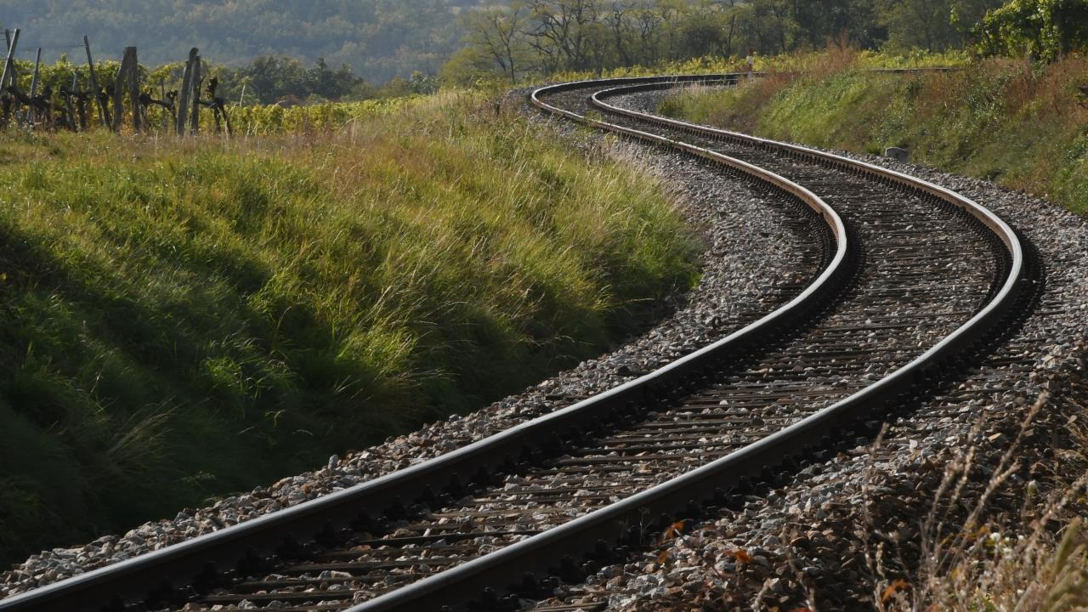
THANK YOU
Moving Europe towards a sustainable and safe railway system without frontiers.
Follow us:

